Slide 1
SIGGRAPH Asia Figures
Presenter: Seunghwan Kim (overnap@khu.ac.kr)

Slide 2
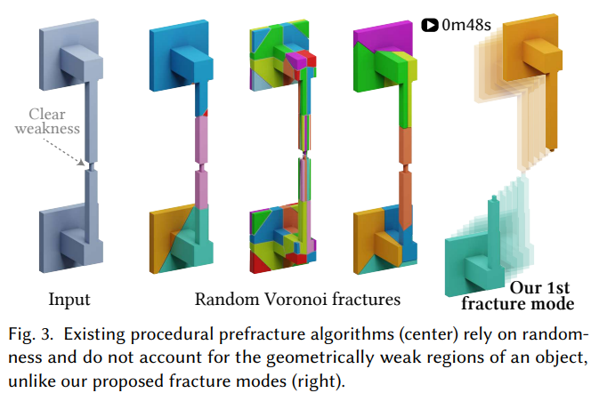
Figure 1: compare with existing method

Slide 3
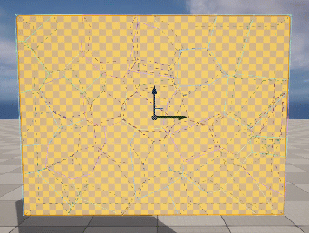
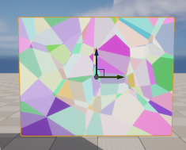
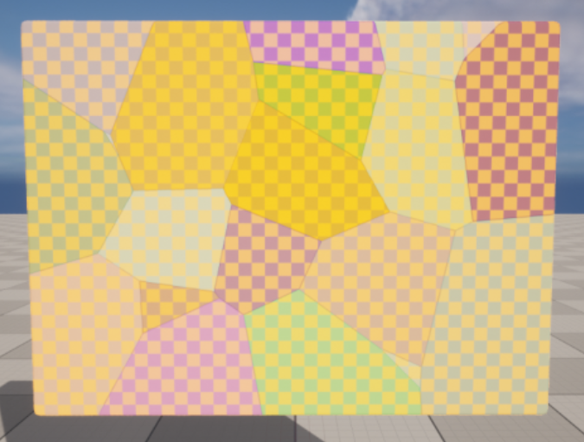
Figure 2: prefractured mesh generation
Our network replaces
(1)
Voronoi
diagram
(2)
Clustering
Original Mesh
Pieces
Groups (larger pieces)
Typical generation process of prefractured mesh. (1) The target mesh is broken into fine pieces, (2) and then they are clustered into groups (larger pieces.) Our deep neural network replaces (2) to obtain realistic prefracutred mesh.

Slide 4
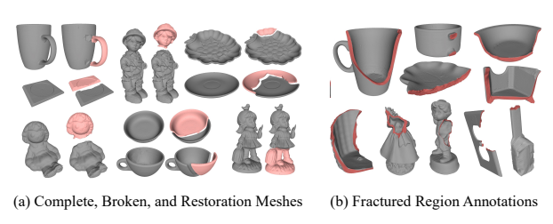
Figure 3: showcase

Slide 5
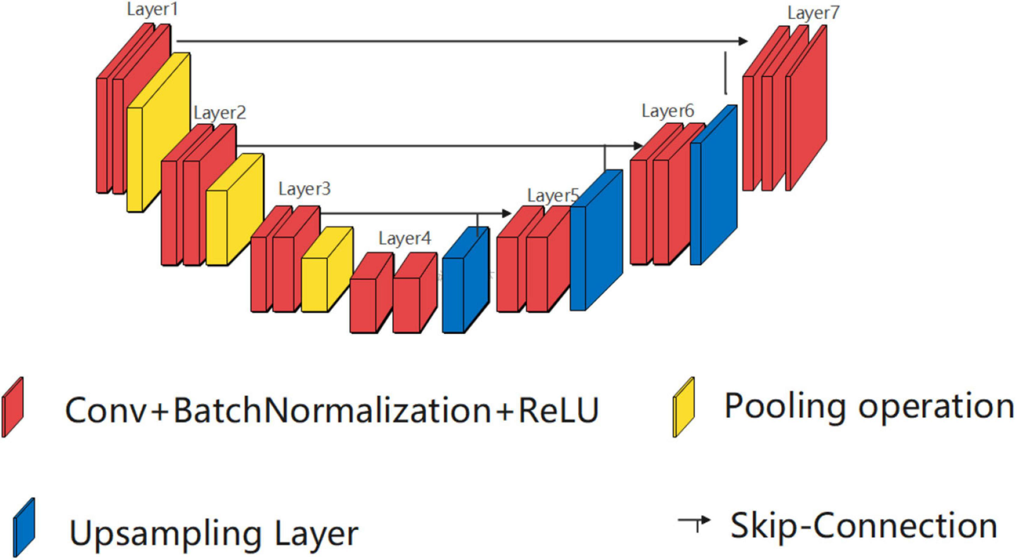
Figure 4: network and loss modeling
NxC
NxN
NxC
(NxC)^T
(1) Point Transformer
(2) Group membership
(3) Pairwise group identity
Proposed network architecture. (1) We explot Point Transformer [1] as a backbone. (2) We define the softmax of output as the probability that each point in N belongs to each group in C. (3) Matrix multiplication of (2) derives pairwise group identity, which provides permutation-invariant loss to group.

Slide 6
Writing
There are no metrics to show numerically in the experiments
Because it is impossible to calculate general segmentation measures
Should I just show a bunch of showcases?

Slide 7
Others?

Slide 8
Thank you for listening
Presenter: Seunghwan Kim (overnap@khu.ac.kr)

